Slide 1
Credit Suisse FinStats - 2017
Team Name | Closed & Bounded
Members | Suraj Kumar Khalid Mushtaq Saswata Majumder

Slide 2
Structure of Presentation
Mathematical Modeling
Modeling non-linear constraints as linear constraints using Integer Linear Programming
Optimization Problem for Risk Averse and Risk Neutral
Optimal Portfolio Design and Results (Excel)
Risk Neutral
Risk Averse
R pseudo - algorithm to determine weights in Risk Neutral Person
Portfolio Performance over the Next 3 Months
Price Modeling and Accuracy Comparison
Pseudo Algorithm for Periodic Rebalancing in R

Slide 3
Mathematical Modeling

Slide 4
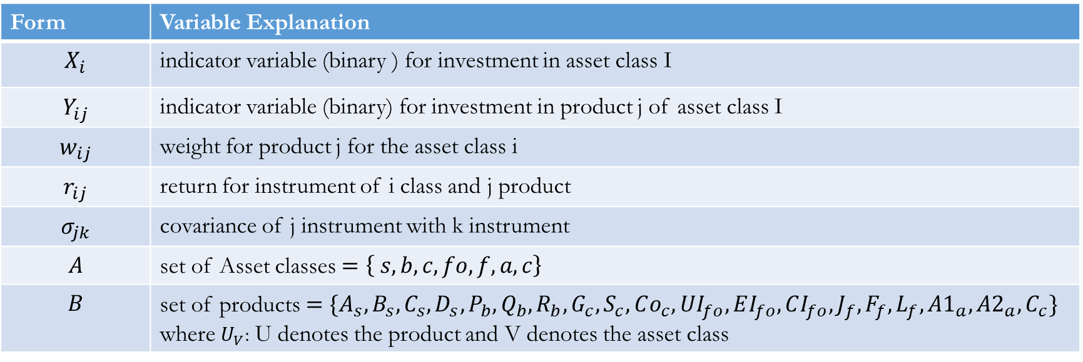
Variables
Mathematical Model
Form | Variable Explanation
$$X_{i}$$ | indicator variable (binary ) for investment in asset class I
$$Y_{ij}$$ | indicator variable (binary) for investment in product j of asset class I
$$w_{ij}$$ | weight for product j for the asset class i
$$r_{ij}$$ | return for instrument of i class and j product
$$σ_{jk}$$ | covariance of j instrument with k instrument
$$A$$ | set of Asset classes $=\left\{ s, b, c, fo,f,a,c\right\}$
$$B$$ | set of products $=\{A_{s}, B_{s},C_{s},D_{s},P_{b},Q_{b},R_{b},G_{c},S_{c},Co_{c},UI_{fo},EI_{fo},CI_{fo}, J_{f},F_{f},L_{f},A1_{a},A2_{a},C_{c}\}$ where $U_{V}$: U denotes the product and V denotes the asset class

Slide 5
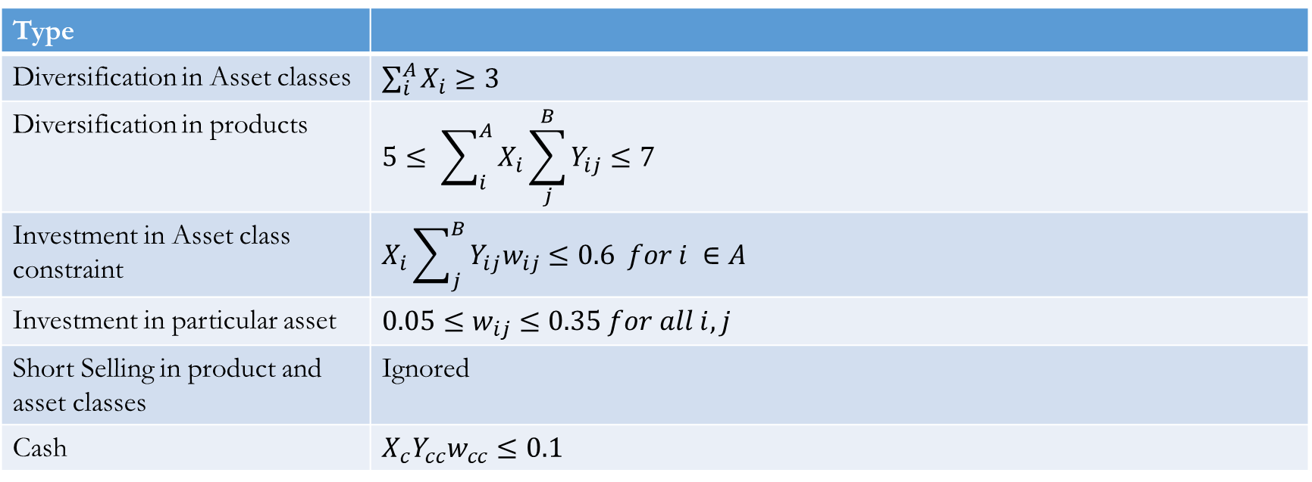
Non Linear Constraints
Type
Diversification in Asset classes | $\sum_{i}^{A}{X_{i}}≥3$
Diversification in products | $$5≤ \sum_{i}^{A}{X_{i}\sum_{j}^{B}{Y_{ij}}}≤7$$
Investment in Asset class constraint | $$X_{i}\sum_{j}^{B}{Y_{ij}w_{ij}≤0.6 for i ∈A}$$
Investment in particular asset | $$0.05≤w_{ij}≤0.35 for all i, j$$
Short Selling in product and asset classes | Ignored
Cash | $$X_{c}Y_{cc}w_{cc}≤0.1$$

Slide 6
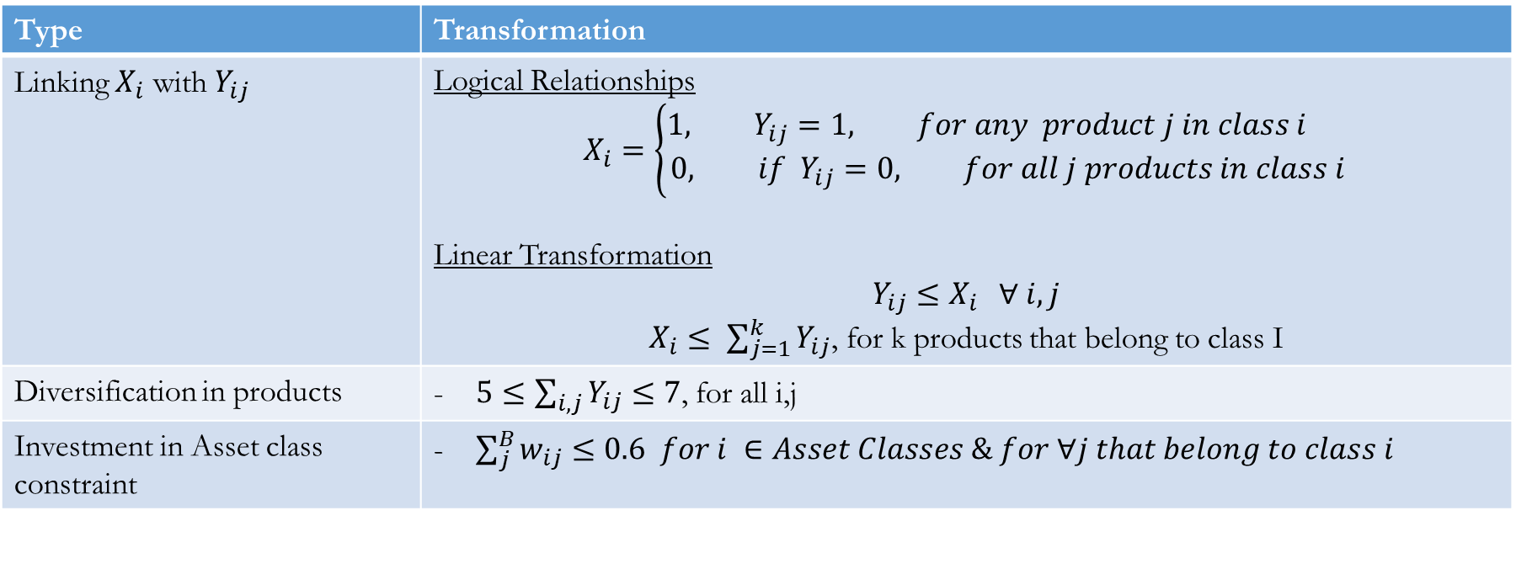
Integer Linear Programing
- To transform the non-linear constraints between the indicator variables of $X_{j}, Y_{ij}$and $w_{ij}$ to linear constraints
Type | Transformation
Linking $X_{i}$ with $Y_{ij}$ | Logical Relationships $$X_{i}=\left\{\begin{aligned}1, Y_{ij}=1, for any product j in class i \\ 0, if Y_{ij}=0, for all j products in class i\end{aligned}\right.$$ Linear Transformation $$Y_{ij}≤X_{i} ∀ i,j$$ $X_{i}≤ \sum_{j=1}^{k}{Y_{ij}}$, for k products that belong to class I
Diversification in products | - $5≤\sum_{i,j}{Y_{ij}}≤7$, for all i,j
Investment in Asset class constraint | - $\sum_{j}^{B}{w_{ij}≤0.6 for i ∈Asset Classes \& for ∀j that belong to class i}$

Slide 7
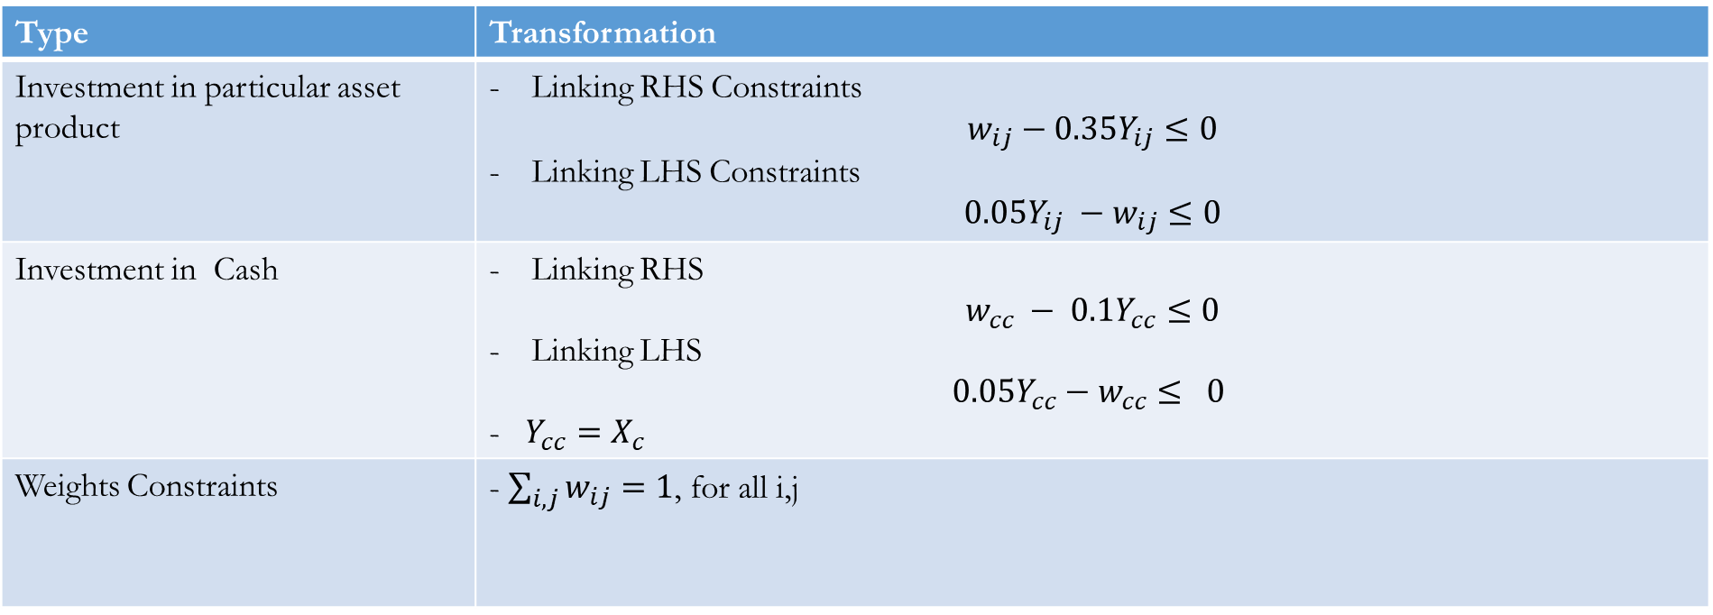
Integer Linear Programing
Type | Transformation
Investment in particular asset product | Linking RHS Constraints $$w_{ij}−0.35Y_{ij}≤0$$ Linking LHS Constraints $$0.05Y_{ij} −w_{ij}≤0$$
Investment in Cash | Linking RHS $$w_{cc} − 0.1Y_{cc}≤0$$ Linking LHS $$0.05Y_{cc}−w_{cc}≤ 0$$ - $Y_{cc}=X_{c}$
Weights Constraints | - $\sum_{i,j}{w_{ij}}=1$, for all i,j

Slide 8
Portfolio Optimization

Slide 9
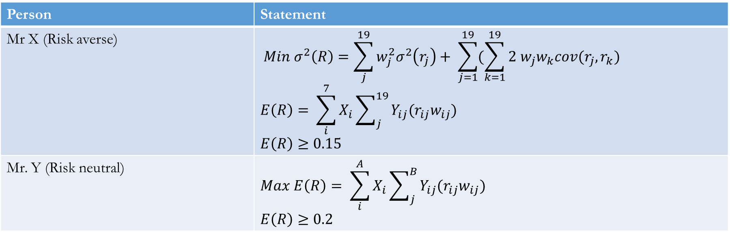
Investor Problem
Person | Statement
Mr X (Risk averse) | $$Min σ^{2}\left(R\right)=\sum_{j}^{19}{w_{j}^{2}σ^{2}\left(r_{j}\right)+ \sum_{j=1}^{19}{(\sum_{k=1}^{19}{2 w_{j}w_{k}cov(r_{j},r_{k}})}}$$ $$E\left(R\right)= \sum_{i}^{7}{X_{i}\sum_{j}^{19}{Y_{ij}(r_{ij}w_{ij})}}$$ $$E\left(R\right)≥0.15$$
Mr. Y (Risk neutral) | $$Max E\left(R\right)= \sum_{i}^{A}{X_{i}\sum_{j}^{B}{Y_{ij}(r_{ij}w_{ij})}}$$ $$E\left(R\right)≥0.2$$

Slide 10
Part A: Portfolio Optimization
Assumptions
Short-selling is not allowed. Thus all the variables are assumed to be non-negative
Ignored the transaction costs for optimization.
For missing values in the data, simple average of the previous and next day returns has been used to impute the value

Slide 11
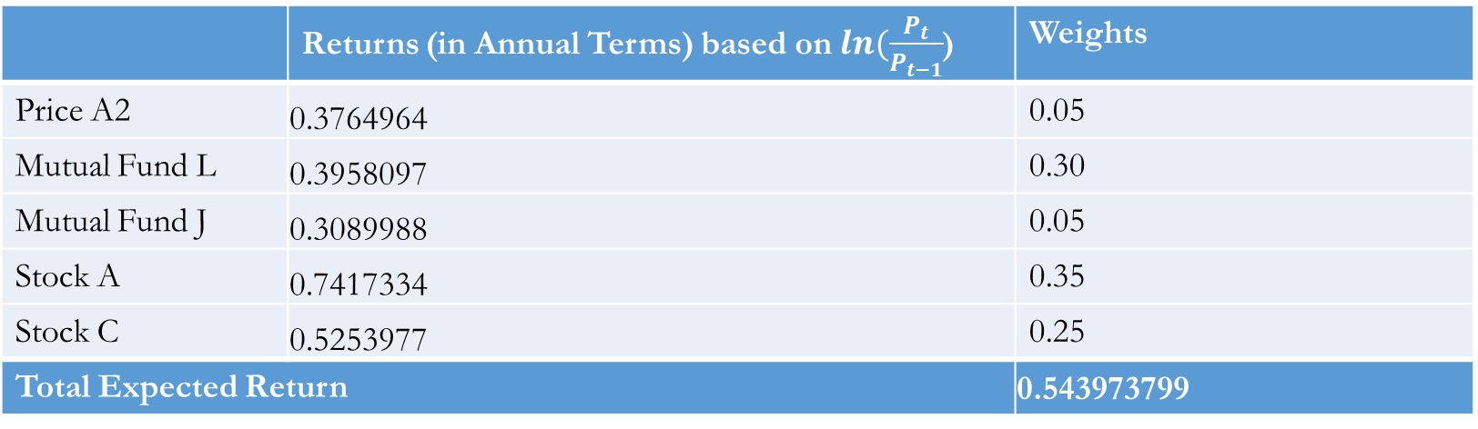
Risk Neutral Person ( Mr.Y )
 | Returns (in Annual Terms) based on $ln(\frac{P_{t}}{P_{t−1}}$) | Weights
Price A2 | 0.3764964 | 0.05
Mutual Fund L | 0.3958097 | 0.30
Mutual Fund J | 0.3089988 | 0.05
Stock A | 0.7417334 | 0.35
Stock C | 0.5253977 | 0.25
Total Expected Return |  | 0.543973799

Slide 12
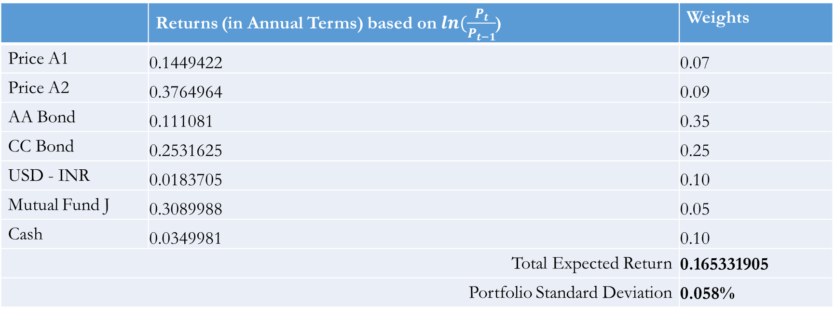
Risk Averse Person ( Mr. X )
 | Returns (in Annual Terms) based on $ln(\frac{P_{t}}{P_{t−1}}$) | Weights
Price A1 | 0.1449422 | 0.07
Price A2 | 0.3764964 | 0.09
AA Bond | 0.111081 | 0.35
CC Bond | 0.2531625 | 0.25
USD - INR | 0.0183705 | 0.10
Mutual Fund J | 0.3089988 | 0.05
Cash | 0.0349981 | 0.10
Total Expected Return |  | 0.165331905
Portfolio Standard Deviation |  | 0.058%
NOTE: Here the convergence issues were faced, as standard deviation ranged from 0.058% to 0.3% with corresponding return ranging from 0.15 to 0.17. It may be because of GRG Non-linear excel optimization. The better solution could have been obtained by using R quad package to do quadratic optimization using linear constraints

Slide 13
Risk Neutral Algorithm in R
Get the input of named returns vectors which corresponds return of security with its name
To satisfy the Asset class diversification constraints, do as follows
Get the best products from each of the asset class
Select the best 3 products of now available best 7 products
Give these 3 best products the weight of 0.35
Now given that no. of asset product should range from 5 to 7 And since 3 has already been choosen. So Now select products in range of 2 to 4.
Run the for loop for j = 2 to 4, j = no. of remaining products to be choosen
For j = 2, select best 2 out of 16(19-3), assign the weights using lp function in r, calculate, ER1
The weights assigned should satisfy the weights constraints of products and classes
For j = 3, select best 3 out of 16(19-3), assign the weights using lp function in r, calculate, ER2
For j = 4, select best 4 out of 16(19-3), assign the weights using lp function in r, calculate, ER3
Now select the best ER of these three ERs, uses those weights at the outcome

Slide 14
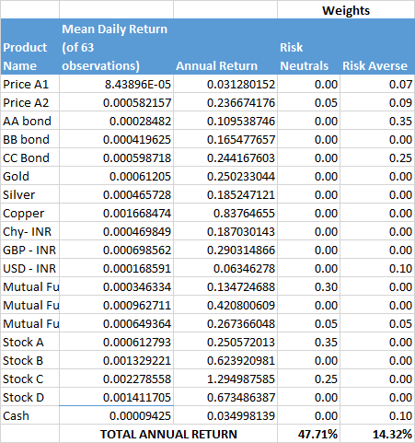
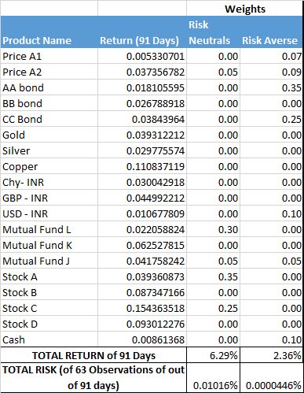
Part D: Actual Return/Risk of Portfolio
For Mr. Y, the returns requirements are satisfied
For Mr X, the expected return requirement of atleast equal to 15% is not satisfied
The value of observed risk or standard deviation is too low. More careful analysis needs to be done

Slide 15
Price Modeling

Slide 16
Comparison of Geometric Brownian Motion vs Regression Technique
Geometric Brownian Motion is mostly preferred as compared to the regression techniques this is due the fact that regression provides an estimate of prices without taking in to account random variation of prices in the short run. Geometric Brownian Motion Method is able to correct this flaw by incorporating “μ dt” which takes in to account the expected return over period t and “σ δ sqrt(dt)” term which is representative of the random motion of prices around it’s expected value. The expected volatility “σ” is multiplied by a random component “δ sqrt(dt)”. The weight of the random component increases as “dt” increases.

Slide 17
Geometric Brownian Model
r_{t} = S(t) – S(t-1)/S(t-1) 1 + r_{t} = S(t) / S(t-1) Assumption log ( 1 + r_{t}) = r_{t} r_{t} = log (S (t) / S(t-1))
We expect prices of assets to increase over time in the long run but in the short run the prices of the assets are expected to showcase random motion. The random motion is taken into account with the help of factor B(t).

Slide 18
Geometric Brownian Model
S(t) = S₀ (exp(r(t)) r(t) log normally distributed with mean μ and variance σ r(t) = σ B(dt) + μ dt {return over period t} B(t) = δ sqrt(t) {Random volatility} σ – expected volatility δ – random draw from Standard Normal Distribution
{S(t) - S(t-1)}/ (S(t-1) = r_{t} r(t) = σ B(dt) + μ dt S(t) = S(t-1) {1+ σ δ sqrt(t) + μ dt} dt – weight of time period difference given to each price observation {lies between 0 and 1} dt = 1/no. of days of simulation dt = 1/20

Slide 19

Accuracy Check
Mean Absolute Deviation Percentage Error = $\frac{100}{n}∗ Σ\frac{Actual value −Forecast value }{Actual value}$
Price A1 | Price A2 | AA bond | BB bond | CC Bond | Gold | Silver | Copper | Chy- INR | GBP - INR
1.0960947 | 0.5644629 | 0.24569329 | 0.3978416 | 0.5372793 | 2.298514 | 5.513423 | 2.341474 | 0.65248377 | 1.01996644
USD - INR | Index | Mutual Fund L | Mutual Fund K | Mutual Fund J | Stock A | Stock B | Stock C | Stock D
0.77878692 | 2.13078 | 1.145578111 | 2.444517683 | 1.316122966 | 4.796227 | 3.154198 | 1.85684 | 3.258942

Slide 20
Periodic Rebalancing Algorithm

Slide 21
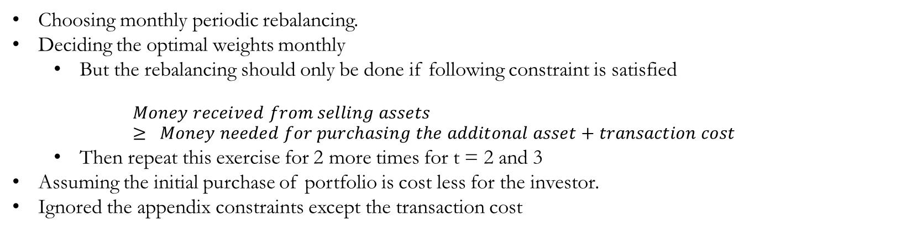
Part E: Periodic Rebalancing Algorithm
Instruction
Choosing monthly periodic rebalancing.
Deciding the optimal weights monthly
But the rebalancing should only be done if following constraint is satisfied
$$Money received from selling assets≥ Money needed for purchasing the additonal asset+transaction cost$$
Then repeat this exercise for 2 more times for t = 2 and 3
Assuming the initial purchase of portfolio is cost less for the investor.
Ignored the appendix constraints except the transaction cost

Slide 22
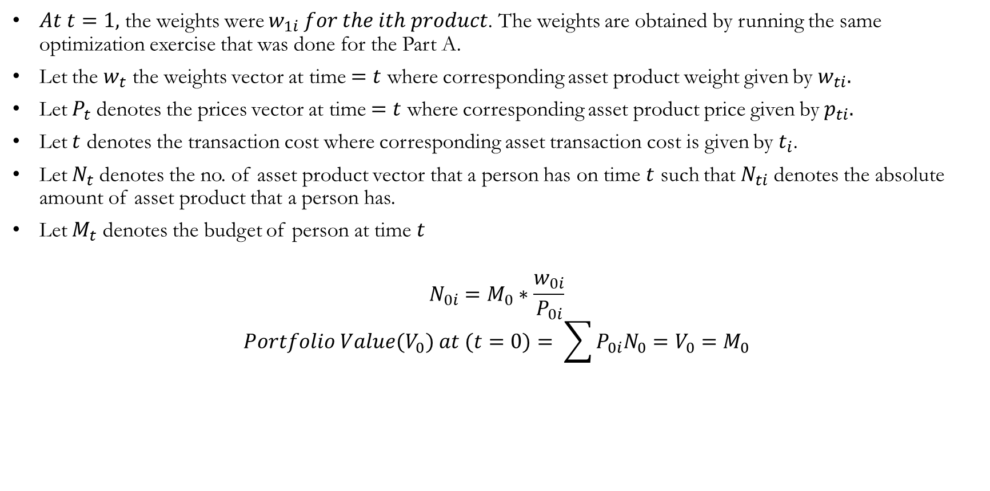
Algorithm
$At t=1,$ the weights were $w_{1i} for the ith product$. The weights are obtained by running the same optimization exercise that was done for the Part A.
Let the $w_{t}$ the weights vector at time $=t$ where corresponding asset product weight given by $w_{ti}.$
Let $P_{t}$ denotes the prices vector at time $=t$ where corresponding asset product price given by $p_{ti}.$
Let $t$ denotes the transaction cost where corresponding asset transaction cost is given by $t_{i}$.
Let $N_{t}$ denotes the no. of asset product vector that a person has on time $t$ such that $N_{ti}$ denotes the absolute amount of asset product that a person has.
Let $M_{t}$ denotes the budget of person at time $t$
$$N_{0i}=M_{0}∗\frac{w_{0i}}{P_{0i}}$$
$$Portfolio Value(V_{0}) at (t=0)= \sum{P_{0i}N_{0}=V_{0}=M_{0}}$$

Slide 23
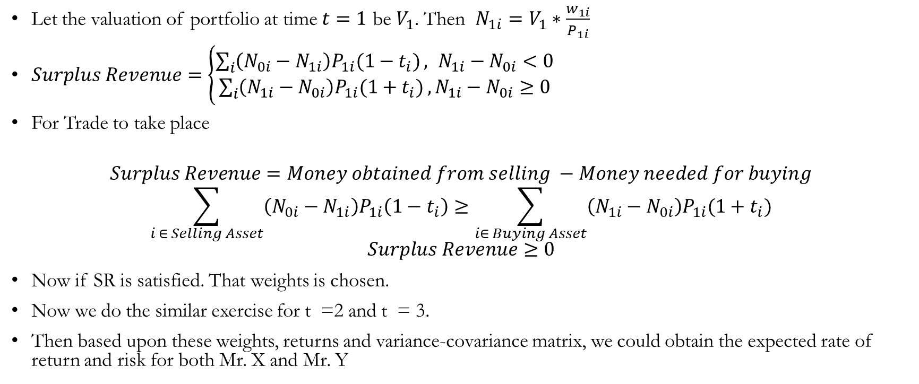
Algorithm
Let the valuation of portfolio at time $t=1$ be $V_{1}$. Then $N_{1i}=V_{1}∗\frac{w_{1i}}{P_{1i}}$
$Surplus Revenue=\left\{\begin{aligned}\sum_{i}{\left(N_{0i}−N_{1i}\right)P_{1i}(1−t_{i})}, N_{1i}−N_{0i}<0 \\ &\sum_{i}{\left(N_{1i}−N_{0i}\right)P_{1i}(1+t_{i})},N_{1i}−N_{0i}≥0\end{aligned}\right.$
For Trade to take place
$$Surplus Revenue=Money obtained from selling −Money needed for buying$$
$$\sum_{i ∈ Selling Asset}{\left(N_{0i}−N_{1i}\right)P_{1i}\left(1−t_{i}\right)≥\sum_{i∈ Buying Asset}{\left(N_{1i}−N_{0i}\right)P_{1i}(1+t_{i})}}$$
$$Surplus Revenue≥0$$
Now if SR is satisfied. That weights is chosen.
Now we do the similar exercise for t =2 and t = 3.
Then based upon these weights, returns and variance-covariance matrix, we could obtain the expected rate of return and risk for both Mr. X and Mr. Y

Slide 24
Questions and Answers

